Slide 1
UNIT-3 Fluid Navigation

Slide 2
Introduction
Navigation is key to successfully operating interactive applications, such as installing a mobile app, filling in a survey, or purchasing a train ticket (task navigation). It is also the key to finding information on a website or browsing social media (web navigation) or to finding the action needed in a desktop application (command menu navigation).

Slide 3
The goal for designers is to enable fluid navigation that allows users to gracefully and confidently get to where they want to go, explore novel possible routes, and backtrack when necessary. Navigation depends on recognition of landmarks that travelers use to guide their choices, which differs greatly from search, which requires users to describe what they want by typing keywords in a blank search box

Slide 4
While the search box is the main technique to initiate the process of finding information in vast information spaces (like the internet or digital libraries), navigation techniques such as small or large menus, embedded links, or tool palettes are the workhorses of navigation. Users indicate their choices with a touch, tap, or swipe of the finger or by using a pointing device

Slide 5
Navigation by Selection
For example, maps can orient users about the geography of the area before users select an item of interest, and calendars or timelines can inform users of availability and constraints before a date or time is selected. Interactive visualization of information can also help analysts navigate large amount of data in a fluid visual manner.

Slide 6
The simplest case of explicit menus is a binary menu for yes/no, true/false choices .Another example of a simple menu is the grid menu popularized by mobile devices, with a small set of icons and labels).
When users need to make a series of choices (e.g., in a survey or to select parameters of an application), there are well-established methods of presenting choices. Radio buttons support single-item selection from a multiple-item menu, while check boxes allow the selection of one or more items in a menu.
A multiple-selection menu is a convenient method for handling multiple binary choices, since the user is able to scan the full list of items while deciding Unavailable choices can be grayed out

Slide 7
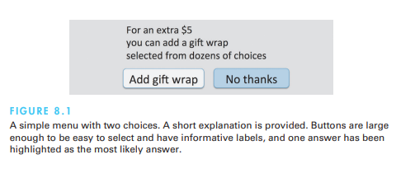

Slide 8
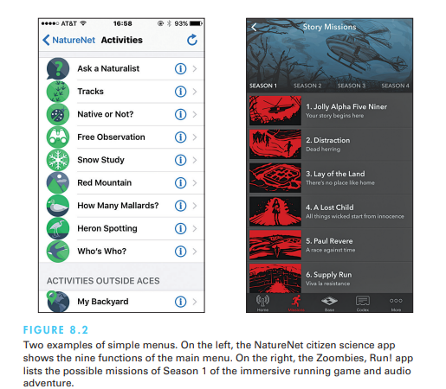

Slide 9
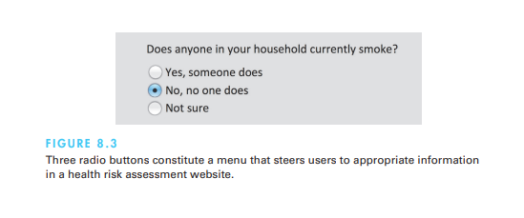

Slide 10
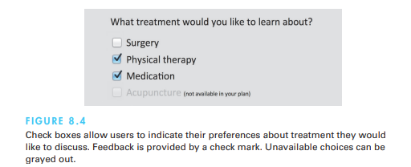

Slide 11
Menu bars, pop-up menus, toolbars, palettes, and ribbons
Menu bars are typically found at the top of the each application or both at the top and on the side of the screen. Common items in desktop or tablet applications are File, Edit, View, and Help, and menus that follow this order will seem familiar to most users. Clicking on a menu title brings up a list of related items, and users can then make a selection by moving the pointing device over the items (which respond by highlighting) and clicking on the desired choice. Since positional constancy is such a strong principle, when an item is not available for selection, it is important to gray it out rather than removing it from the list.

Slide 12
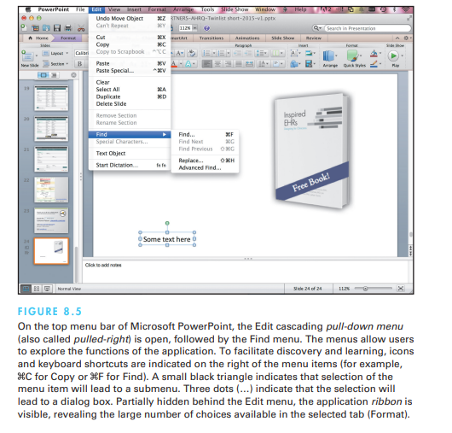

Slide 13
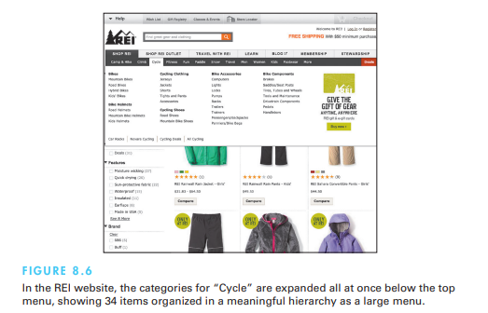

Slide 14
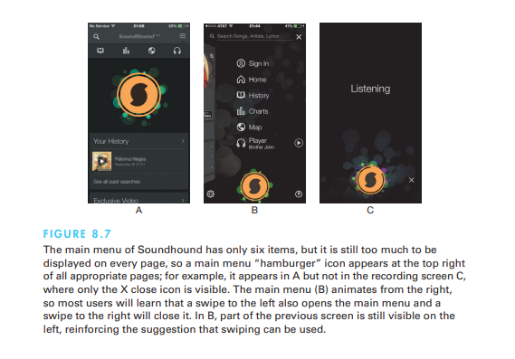

Slide 15
Shortcuts and gestures for rapid interaction
For rapid selection, keyboard shortcuts (also sometime called hotkeys, such as Ctrl-C on PCs or -C on Macs for Copy) are essential for expert users using desktop computers . Users can memorize the keystrokes for the menu items they use often and thus speed up the interaction considerably. The first letter of the command is often used for the shortcut to favor memorability, but caution is required to avoid collisions. If at all possible, shortcuts should be used consistently across applications; for example, Ctrl-S on a PC or -S on a Mac is usually used for Save and Ctrl-P or -P for Print. Keyboard shortcuts should be indicated next to their corresponding menu items and in the tooltip of the menu icons.

Slide 16
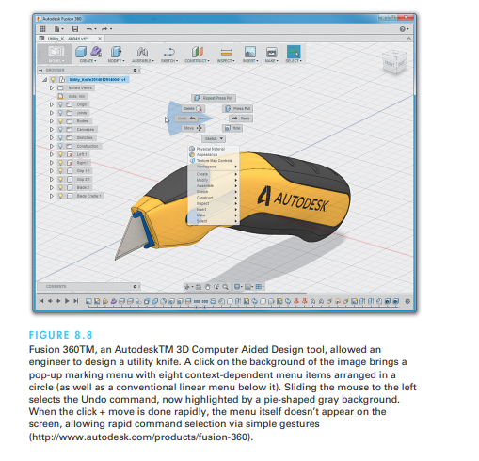

Slide 17
Long lists
Sometimes the list of menu items may be longer than the 30 to 40 lines that can reasonably fit on a display. One common solution is to create a tree-structured menu sometimes the desire to limit the interface to one conceptual menu is strong—for example, when users must select a state from the 50 states in the United States or a country from an extensive list of possibilities. Typical lists are alphabetically ordered, but categorical lists may be useful. The principles of menu-list sequencing apply
Scrolling menus, combo boxes, and fisheye menus
Sliders and alphasliders
Two-dimensional mega menus

Slide 18
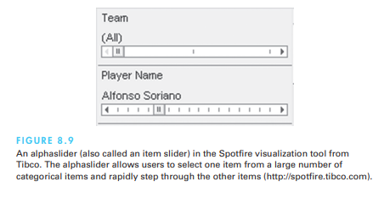

Slide 19
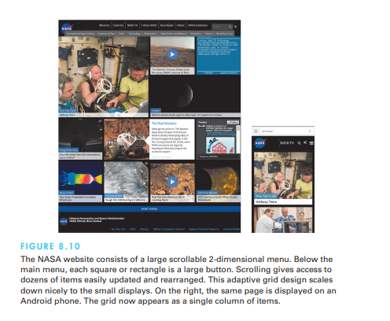

Slide 20
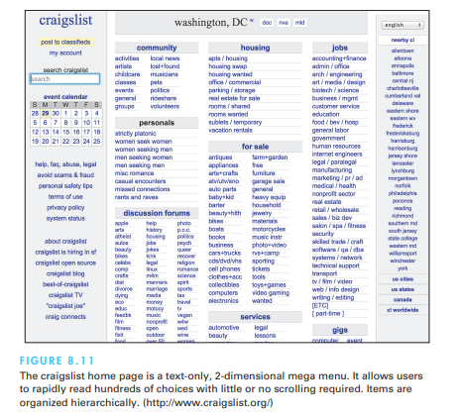

Slide 21
Linear versus simultaneous presentation
Often, a sequence of interdependent menus can be used to guide users through a series of choices. For example, a pizza-ordering interface might include a linear sequence of menus in which users choose the size (small, medium, or large), thickness (thick, normal, or thin crust), and finally toppings. Other familiar examples are online examinations that have sequences of multiple-choice test items, each made up as a menu, or wizards (a Microsoft term) that steer users through software installation by presenting a sequence of menu options

Slide 22
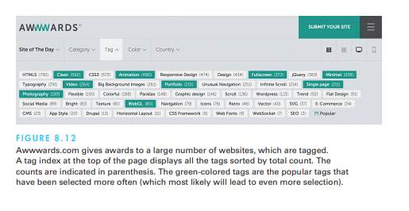

Slide 23
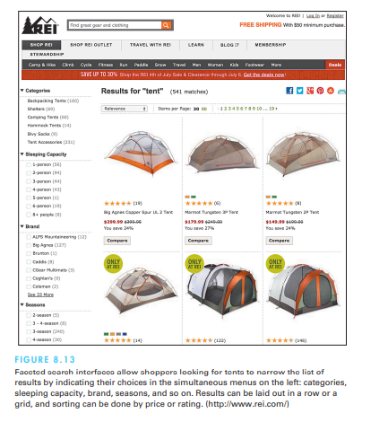

Slide 24
Small Displays
While most designs adapt fairly easily from desktop displays to the larger tablets (once the design has been reviewed for touchability), small displays make most desktop designs impractical, and dumbed-down designs are very likely to fail. Small displays require a radical rethinking of what functionalities should be included and often lead to novel interface and menu designs specifically adapted to particular devices and applications

Slide 25
The smaller the screen, the more temporal the interface becomes (all the way to entirely linear audio interfaces when no display is available). For example, linear sequences of menus are possible, while simultaneous menus are much harder to fit in. On tiny devices (such as watches or fitness wearable's), a deck of card menu can be used, where each single tap advances to the next choice and a long press or two-finger press may select the item to access more information. Animated attention-catching ticker menus have also been used. Users don’t need to manually scroll or page through the menu items, and with a single touch they can stop the scrolling and select an item in view. On the other hand, having to wait for an item to appear or reappear will be frustrating to some users, especially as the number of items grows

Slide 26
Design considerations for small displays
Simplify: Less is more.
• Strive to reduce or eliminate data entry.
• Learn ability is key.
• Consider use frequency and importance.
• Plan for interruptions.
• Use of contextual information.
• Make clear what is selectable and what is not.
• Leave room for scroll and swipe gestures to avoid inadvertent actions.
• Consider relegating less important functions to other platforms.

Slide 27
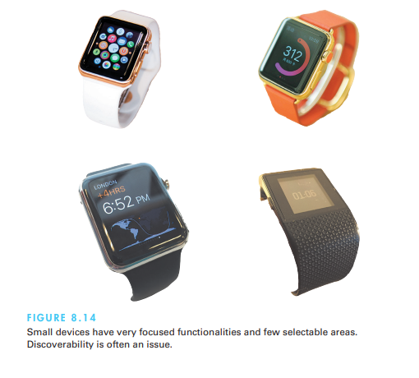

Slide 28
Content Organization
Meaningful grouping and sequencing of choices, along with careful editing of titles and labels and appropriate layout design, can lead to easier-to-learn menus and increased navigation speed. In this section, This section reviews the content organization issues and provides guidelines for design. This area of design has been heavily researched in the context of traditional menus for desktop applications, but most results are useful for website and phone application designs (Krug, 2014). Web pages act as large menus where items are the embedded links or buttons that can be used to navigate to another page

Slide 29
Structure and breath versus depth
When a collection of items grows, designers can form categories of similar items, creating a tree structure . Some collections can be partitioned easily into mutually exclusive groups with distinctive identifiers. For example, the products in an online grocery store can be organized into categories such as produce, meat, dairy, cleaning products, and so on. Produce can then be organized into vegetables, fruits, and nuts, while dairy is organized into milk, cheese, yogurt, and so on.

Slide 30
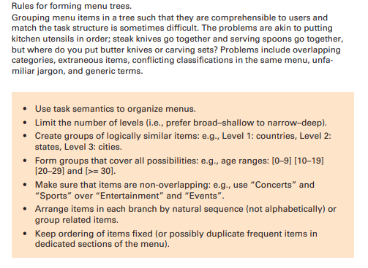

Slide 31
Sequence, phrasing, and layout Sequence
Once the items in a menu have been chosen, the designer is still confronted with the choice of presentation sequence. If the items have a natural sequence—such as days of the week, chapters in a book, or sizes of eggs—the decision is trivial. Many cases have no task-related ordering, though, so the designer must choose from either alphabetic order, grouping of related items, and most frequently used items first. Categorical organization is generally preferable over alphabetical. Using frequency of use does speed up selection of the topmost items, but the loss of a meaningful ordering for low-frequency items may be disruptive, so it is best limited to small lists

Slide 32
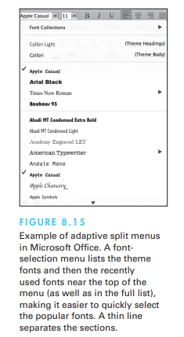

Slide 33
Phrasing
For single menus, a simple descriptive title that identifies the situation is all that is necessary. For tree-structured menus, choosing titles is more difficult. One helpful rule is to use the words used for the menu items as the titles for the submenu or next pages. For example, it is reassuring to users to find that when they select “Business and financial services”, they are shown a display that is titled “Business and financial services”. It might be unsettling to get a display titled “Managing your money”, even though the intent is similar. For webpages, a distinctive short title displayed as browser tab label will help users return to the page after they visit other tabs. A distinctive icon improves the tab label as well.

Slide 34
Layout
While the layout of applications and websites can be assisted by the use of templates and website management tools, designers who establish guidelines for consistency across dozens or hundreds of screens will reduce users’ anxiety by offering predictability (see Section 3.2). The following elements can be included:
• Titles. Some people prefer centered titles, but left justification is also acceptable.
• Item placement. Typically, items are left justified, with the item number or letter preceding the item description. Blank lines may be used to separate meaningful groups of items. If multiple columns are used, a consistent pattern of numbering or lettering should be used (for example, it is easier to scan down columns than across rows).
• Instructions. The instructions should be identical in each menu and should be placed in the same position. This rule includes instructions about traversals, help, or function-key usage.
• Error messages. If the users make unacceptable choices, the error messages should appear in a consistent position and should use consistent terminology and syntax. Graying out unacceptable choices will help reduce errors

Slide 35
Audio Menus
Audio menus found in interactive voice response (IVR) systems (Lewis, 2010) are useful when hands and eyes are busy, such as when users are driving or testing equipment and are ubiquitous in phone surveys or services and public-access situations that need to accommodate blind or vision-impaired users, such as information kiosks or voting machines.
With audio menus, instruction prompts and lists of options are spoken to users, who respond by using the keys of a keyboard or phone or by speaking. While visual menus have the distinct advantage of persistence, audio menus have to be memorized. Similarly, visual highlighting can confirm users’ selections, while audio menus have to provide a confirmation step following the selection. As the list of options is read to them, users must compare each proposed option with their goal and place it on a scale from no match to perfect match.

Slide 36
To reduce dependence on short-term memory, it is preferable to describe the item first and then give the number. A way to repeat the list of options and an exit mechanism must be provided (preferably by detecting user inaction). Complex and deep menu structures should be avoided. A simple guideline is to limit the number of choices to three or four to avoid memorization problems, but this rule should be re-evaluated in light of the application. For example, a theater information system will benefit from using a longer list of all the movie titles rather than breaking them into two smaller, arbitrarily grouped menus. Dial-ahead capabilities allow repeat users to skip through the prompts.

Slide 37
Form fill-in
There is a paucity of empirical research on form fill-in, but several design guidelines have emerged from practitioners (Jarrett and Gaffney, 2008). Software tools simplify design, help to ensure consistency, ease maintenance, and speed implementation, but even with excellent tools, the designer must still make many complex decisions. The elements of form fill-in design include the following:
Meaningful title. Identify the topic and avoid computer terminology.

Slide 38
Comprehensible instructions. Describe the user’s tasks in familiar terminology. Be brief; if more information is needed, make a set of help screens available to the novice user. A useful rule is to use the word “type” for entering information and the word “press” for special keys such as the Tab, Enter, or cursor movement (arrow) keys. Since “Enter” often refers to the special key with that name, avoid using it in the instructions (for example, do not use “Enter the address”; instead, stick with “Type the address”). Once a grammatical style for instructions is developed, be careful to apply that style consistently.

Slide 39
Label the fields. Place the label in a consistent location (e.g., top or left of the field). A less desirable location is to place labels inside the fields, using a grayedout font. It saves space, but the labels disappear as soon as users start typing, requiring users to remember what is needed, which often leads to errors.
Limit data entry. Make sure all fields are really needed. Carefully set default values (e.g., use the current location). This is particularly important for small displays .for example, using only the zip code instead of the city

Slide 40
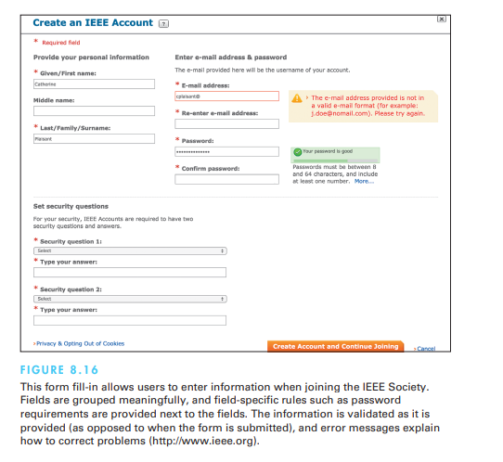

Slide 41
Explanatory messages for fields. Information about a field (e.g., “Your e-mail address will be the user name of your account”) or its permissible values should appear in a standard position, such as next to or below the field, preferably using a different font and style.
Error prevention. Where possible, prevent users from entering incorrect values. For example, in a field requiring a whole number, do not allow the user to enter letters or decimal points.
Error recovery. Summarize errors at the top of the page. Highlight errors in the form. If users enter unacceptable values, indicate permissible values for the field; for example, if the zip code is entered as 28K21 or 2380, the message might be “Zip codes should have 5 digits”.
Immediate feedback. Immediate feedback about errors is preferable. When feedback can be provided only after the entire form has been submitted, the location of the field needing correction should be made clearly visible (for example, by displaying the error message in red next to the field in addition to general instructions at the top of the form).

Slide 42
Logical grouping and sequencing of fields. Related fields should be adjacent and should be aligned with blank spaces for separation between groups. The sequencing should reflect common patterns—for example, city followed by state followed by zip code.
Visually appealing layout of the form. Alignment creates a feeling of order and comprehensibility. For example, the field labels “Name”, “Address”, and “City” can be right-justified so that the data-entry fields are vertically aligned. This layout allows the frequent user to concentrate on the entry fields and to ignore the labels.

Slide 43
Familiar field labels. Common terms should be used. If “Home Address” were replaced by “Domicile”, many users would be uncertain or anxious about what to enter.
Consistent terminology and abbreviations. Prepare a list of terms and acceptable abbreviations and use the list diligently, making additions only after careful consideration. Instead of varying between such terms as “Address”, “Employee Address”, “ADDR.”, and “Addr.”, stick to one term, such as “Address”.
Visible space and boundaries for data-entry fields. Users should be able to see the size of the field and to anticipate whether abbreviations or other trimming strategies will be needed. An appropriately sized box can show the maximum field length.

Slide 44
Convenient cursor movement. Provide a mechanism for moving the cursor between fields using the keyboard, such as the Tab key or cursor-movement arrows.
Required fields clearly marked. For fields that must be filled in, the word “Required” or some other indicator (e.g., *) should be visible. Optional fields should follow required fields whenever possible.
Privacy and data sharing information. Users will be anxious sharing their personal information and want to know how the data will be used and who will have access to it.
Accessibility. For example, make sure the forms are navigable with a screen reader.
Completion signal. It should be clear to the users what they must do when they are finished filling in the fields.

Slide 45
Format-specific fields
Using custom widgets and direct-manipulation interaction techniques can facilitate data entry and reduce errors. Calendars can be used to enter dates, seating maps can help users select airplane seats, and menus using photographs might clarify choices of pizza style.

Slide 46
Apps for touch screen devices need to open the keyboard with the appropriate preset; for example, when a number is requested, the numerical keyword should appear by default. For e-mail addresses, the “@” and “.” buttons need to be shown. For URLs, the “:” and “/” will be handy. Alphabetic fields are customarily left-justified on entry and on display. Numeric fields may be left-justified on entry but then become right-justified on display. When possible, avoid entry and display of leftmost zeros in numeric fields (with zip codes being an exception). Numeric fields with decimal points should line up on the decimal points. Pay special attention to such common fields as these:

Slide 47
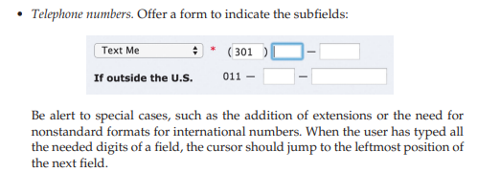

Slide 48
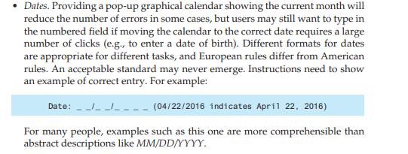

Slide 49
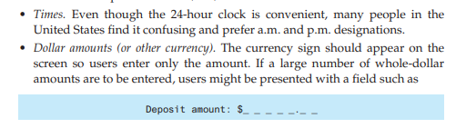

Slide 50
Passwords: When asked to type a password, users also need a means to retrieve or change the password if they have forgotten it, but it is also important to avoid malicious use of that functionality
CAPTCHAs:A CAPTCHA (acronym for Completely Automated Public Turing test to tell Computers and Humans Apart) requires users to type text presented graphically to be illegible to computers. Including an audio option is necessary to make the CAPTCHA accessible to users with visual impairments. Newer versions observe user behavior with the CAPTCHA to predict whether a human or a robot is interacting

Slide 51
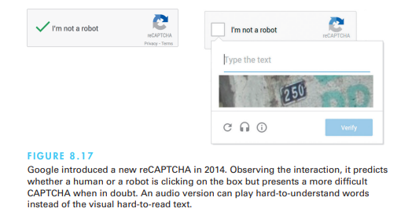

Slide 52
Dialog boxes
Many tasks are interrupted to request users to select options, perform limited data entry, or review alerts and error messages . The most common solution is to provide a dialog box . Dialog-box design combines menu-selection and form fill-in issues with additional concerns about consistency across potentially hundreds of dialog boxes and relationships with other items on the screen. A guidelines document for dialog boxes will help strive for consistency. Dialog boxes should have meaningful titles to identify them, and the titles should have consistent visual properties. Dialog boxes are often shaped and sized to fit each situation, but distinctive sizes or aspect ratios may be used to signal errors, confirmations, or components of the application.

Slide 53
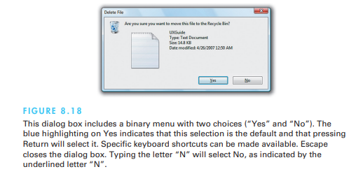

Slide 54
